Slide 4




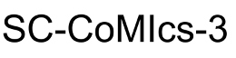
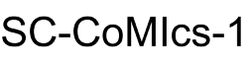
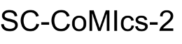



Entity Recognition
Entity
Extraction
100
80
60
40
20
v
Classification

Slide 5
100
80
60
40
20
v

Slide 6
100
80
60
40
20
v

Slide 7
100
80
60
40
20
v

Slide 8
100
95
85
75
65
v

